Slide 1


Data Structure
Dr Swati Gupta & Ms Suman
Faculty
School of Engineering & Technology
K.R. Mangalam University
Unit 3: Sorting and Searching

Slide 2

Objective of the Session
Explain what collisions are and why they occur in hash tables.
Differentiate between various collision resolution techniques such as Chaining and Open Addressing.
Implement collision handling methods including Linear Probing, Quadratic Probing, and Double Hashing.
Analyze the efficiency of different strategies in terms of time complexity and memory usage.

Slide 3

Collision resolution techniques
Collision resolution techniques in hashing are methods used to handle situations
where two different keys hash to the same index in a hash table.

Slide 4
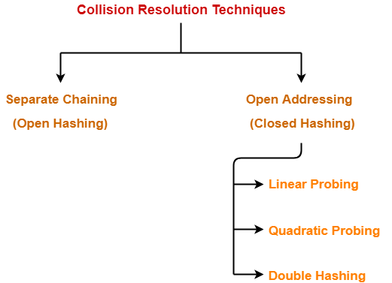
CONT..

Slide 5
common collision resolution techniques
There are several common collision resolution techniques:
Open hashing / Seperate Chaining
Closed hasing / Open Addressing
Separate Chaining: In this technique, each bucket in the hash table is implemented as a linked list.
When a collision occurs, the colliding elements are simply appended to the linked list at that bucket.

Slide 6
CONT..
Open Addressing: In open addressing, all elements are stored in the table itself.
When a collision occurs, the algorithm looks for the next available slot in the table.

Slide 7
CONT..
There are different strategies within open addressing,
such as linear probing (move to the next slot),
quadratic probing (use a quadratic function to find the next slot),
and double hashing (use a second hash function to determine the next slot).

Slide 8
CONT..
a. Linear Probing: A specific form of open addressing where if a collision occurs, the algorithm looks for the next available slot linearly (one slot at a time).
b. Quadratic Probing: Similar to linear probing but uses a quadratic function to determine the next probing position.
The probing sequence is (hash + 1), (hash + 4), (hash + 9), and so on.

Slide 9
CONT..
c. Double Hashing: In this method, a secondary hash function is used to determine the step size for probing.
If a collision occurs, the algorithm probes with steps determined by the secondary hash function until an empty slot is found.

Slide 10
Example Open hashing / Separate Chaining
It is one of the most commonly used collision resolution techniques.
It is usually implemented using linked lists. In separate chaining, each element of the hash table is a linked list.
To store an element in the hash table we insert it into a specific linked list.

Slide 11
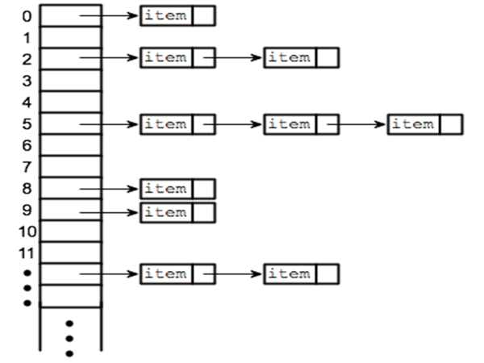
Open Addressing

Slide 12
Assignment 1
Assignment 1:
Part A – Theoretical
Identify one real-world application where chaining is more suitable than open addressing.
Part B – Numerical
Given: Hash function: h(k)=k%10 Keys: {32, 45, 62, 97, 54, 23, 82}
Tasks:
Create a hash table of size 10 using chaining.
Show the linked list at each index.
Illustrate the search process for key = 97.

Slide 13
Assignment 2
Assignment 2:
Part A –
Explain the concept of primary clustering and why it occurs in linear probing.
Suggest one method to reduce primary clustering.
Part B –
Hash function: h(k)=k%7 Table size = 7 Keys: {50, 700, 76, 85, 92, 73}
Tasks:
Insert the keys into the hash table using linear probing.
Show the probing sequence for inserting 85 and 92.
Search for key = 73 and show the steps.

